Slide 1
Bus systems

Slide 2
Universal serial bus (USB)
USB has two types of connectors, in either case, there are four pins on each connector.
The USB uses NRZI (non-return-to-zero-inverted) encoding technique for transmitting packets
NRZI does not change the signal level for the transmission of logic-1, but the signal level is inverted for each change to a logic-0.

Slide 3
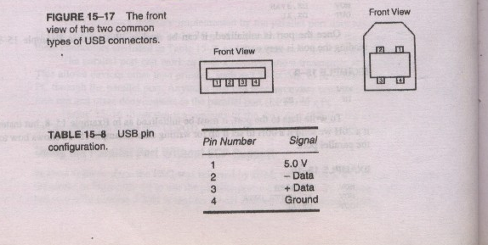
Connector and Pin Configuration

Slide 4

NRZI encoding

Slide 5
PCI Bus System
PCI Stands for Peripheral System Interconnect.
It Has Plug-&-Play Characteristics.
PCI can function with 64 bit data bus and 32 bit address bus, sometimes, these buses are multiplexed.
It contains a series of registers, located in a small memory device on the PCI interface, that contain information about PCI board.
The information allow the computer to automatically configure the PCI card.

Slide 6
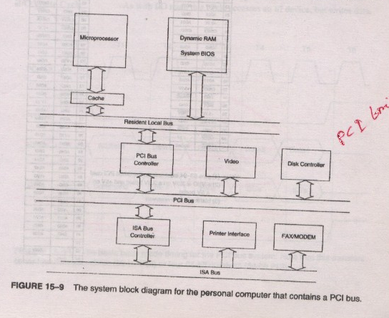
System Structure for PCI Bus

Slide 7
ISA Bus
ISA means Industry Standard Architecture
The main board can accept either an 8-bit ISA card or 16-bit
The only interfaces found for the ISA bus are modems and sound cards

Slide 8
Comparison between PCI and ISA bus
ISA | PCI
ISA Stands for Industry Standard Architecture. | PCI Stands for Peripheral Component Interconnect.
It doesn’t have Plug-&-Play Characteristics. | It has Plug-&-Play Characteristics.
ISA functions with 8 or 16 bit data bus. | PCI functions with 64 bit data bus.
The clocking speed is lower than that of PCI. | The clocking speed is greater than that of ISA.
ISA interfaces modems, sound cards etc. | PCI interfaces video controller, disk controller etc.

